Slide 1
Development of Tools and Websites to facilitate
wider and easy communication with public

Slide 2
ICT IN COURTS
INFORMATION AND COMMUNICATION TECHNOLOGY TO ENSURE QUALITY, RESPONSIVENESS AND TIMELINESS
IN THE JUDICIAL SYSTEM

Slide 3
Indian Judiciary is in urgent need of re-engineering its processes to optimize the use of its human resources and bring about change management by harnessing the potentiality of the available Information and Communication Technology (ICT) to its fullest extent.

Slide 4
The objective of this exercise is to enhance judicial productivity both qualitatively and quantitatively as also make the justice delivery system affordable, accessible, cost effective, transparent and accountable.

Slide 5
One of the references made to the E-Committee is to create support systems by framing policies and implementation plan in following areas:
a) To create training for judges and administrative staff in the courts
b) To create a cadre of trainers and trouble-shooters for each court complex
c) To suggest ways and means to ensure the smooth running of the computer systems, including therein availability of power supply, peripherals, stationary etc.
d) To suggest methods to make access to justice and availability of information more litigant friendly.

Slide 6
In Phase I
• All the Judges in India will have laptops (notebooks) for
discharge of their judicial and administrative functions at the requisite work places with connectivity and appropriately developed skills.
• Awareness and introduction of ICT and computer based
environment in the Judicial System.
• Video conferencing between court and prison at 100 locations.
• A fully developed and highly informative
Website – www.indianjudiciary.in

Slide 7
• Creation of National Judicial Data Grid
• Creation of Committees and High Court Level Committees to monitor and guide the ICT implementation in the court complexes
• Implementation of Wi-Fi at Supreme Court and High Court premise.
• Computer Room at court complexes.

Slide 8
In Phase II, the objective is to create the required ICT and support infrastructure for the Judicial System. This phase envisaged the creation and development of state-of-the art technical facilities for the judicial system such as video-conferencing, digital archives, inter-connectivity of law libraries, digitalization of legal tools like case laws and statute laws, wireless LAN, larger deployment of computer systems and allied hardware. Apart from the ICT hardware installation, there would also be development and implementation of software for judicial and administrative processes in progressively identified sections/departments/activities/processes.

Slide 9
The government had initially rolled out the eCourts project to provide courts with the necessary hardware and software applications to deliver e-services to citizens and to monitor and manage the daily functioning of courts. Phase I of the project has already seen computerisation of over 13000 district and subordinate courts. 95% of this phase is reportedly complete including an operational e-Courts portal and a number of other initiatives:
Case information has been linked to the respective courts where proceedings were held.
Courts now provide online eServices such as cause lists, case status and judgments, to litigants and public through the eCourts portal
Citizens can access the case status information of over 5 crore pending and decided cases and more than one crore orders/ judgments are available online
Judicial Service Centre at the court complexes provide services to litigants and lawyers
According to this source, 14,000 judicial officers have been trained on the use of the Linux OS Ubuntu and 4,000 court staff has been trained to operate the CIS software
ICT infrastructure of the Supreme Court and High Court has been upgraded and 14,309 judicial officers have been provided laptops

Slide 10
Immediate task ahead
1. Automation of Case Management, Processes, Case Filing, Scrutiny, Registration, Case Allocation, Court Proceedings, Details entry of a Case, Case Disposal & restoration, Transfer of Case etc
2. Provision of online services, Certified copies of orders and judgments, Case status, Calculation of court fees, Cause lists, Institution Registers, and Court Diaries
3.Establish information gateways between courts and government agencies. Information exchange with police, prisons, land records department, registration offices etc; distant production/examination of under trial and witnesses through video conferencing
4. Creation of National Judicial Data Grid agencies Monitoring of pendency in the courts
Source : Website of e-Courts

Slide 11
Case Information Software(CIS)
During Phase-I of the eCourts Project, in a very large no of court Complexes, Computer Server Rooms and Judicial Service Centres have been readied. The District and Subordinate Courts as covered in Phase-I of these Court Complexes have already been computerized with Installation of Hardware, LAN etc. and Case Information Software (CIS). Consequently these courts are now providing basic Case related services to litigants and lawyers and the major services are as follows:
Filling at Judicial Service Centre and generation of receipt containing filling number;
Scrutiny objections on the District Court website ;
Copies of Oral Evidence to be uploaded on website, which can be downloaded by lawyers/parties after using login and password for their cases;
Judgements stored in the Server and that can be accessed by authorised person from court or Copying Agency etc.;
Judgement on internet website with search facility;
Cause list on internet with searchable fields ;
Case status on internet;
Daily Orders on internet website;
Complete Court Fee structure on the District Court website.

Slide 12
eCourts National Portal (eCourts.gov.in)
The eCourts National Portal (http://ecourts.gov.in/) was launched on 7th August, 2013. This provides Cause List, Case Status Information in respect of more than 2.5 crores cases (Pending and Decided) and has sometimes reached daily hits in access of 7 lacks which is growing exponentially every week. This is a part of the National Judicial Data Grid that has been made operational and will be improved in near future. The eCourts National Portals also provide training materials for Judicial Officers and Staff, links to District Court website and statistical report that can be used as a Judicial Management Information System. This portal is expected to play a key role in bringing about Judicial Reforms. Every litigant can access information about his/her case from the eCourts National Portal.

Slide 13
District Court Website
Large number of District Courts have launched their websites (Druple Based) for the convenience of litigants and others and these websites have been provided with a template for easy access of case related information.

Slide 14
Push Based SMS Service
In an effort to provide transparent, reliable and quick information to advocates/litigants/petitioners, the district courts initiated sending SMS regarding information related to case filing, registration, case listing, and case disposal, by integrating the CIS with an SMS software viz. SMS Management System for Courts (SMS Court) which was developed by the Software Development Unit (SDU), NIC-Pune. This software uses the service of the NIC SMS-Gateway for sending the SMSes. The SMS software collects only the current date CIS information and uses it for sending the SMSes.

Slide 15
National Judicial Data Grid (NJDG)
On 7th August 2013, Hon’ble the Chief Justice of India launched the eCourts Nationla Portal of the eCourts Project.The Portal showcases the National Judicial Data Grid which provides, inter alia, training materials for Judicial Officers and Staffs and general information to the Public and will eventually be a very powerful mode of communicating all aspect of Judicial reforms. More than 8 thousand Courts have successfully integrated with the NJDG portal and are providing case status, Cause List, Order/Judgement online . Data of more than 2.5 crores pending and disposed cases is available on NJDG at present.

Slide 16
Judicial Service Centre (JSC)
The Judicial Service Centre is set up at each Court Complex which is a citizen service interface counter for provision of various services such as case filing, status enquiry, etc.

Slide 17
Court Location Software (Mobile Application)
This mobile application software is extensively used for getting the exact location of the court. The mobile application is provided by the eCommittee and by using this application any one can know the list of nearby courts with in 25 kilometres and it will show the navigation to the selected court with the use of GPS (Global Positioning System) Technology. Court Location Software (Mobile Application)

Slide 18
CIS 1.1 Vs. CIS 2.0
1. In CIS 2.0 in the home screen we may able to get the total no. of pending cases, disposal for the month, total undated cases and total records in the Cause List can be found whereas in CIS 1.1 only undated cases are there.
2. Pendency Bar Chart and Pendency Pie Chart also available in CIS 2.0 whereas in CIS 1.1 this feature not available.
3. Year wise percentage of cases from the total number of cases available in CIS 2.0 whereas in CIS 1.1 it is not available.
4. We may switch over to all the establishments from a common establishment after login in CIS 2.0 but in CIS 1.1 we need to logout from current establishment in order to login into another establishment.
5. Searching menu items is available in CIS 2.0 and in CIS 1.1 it is not available.

Slide 19
6. Next date can be changed from the home page itself in CIS 2.0 but in CIS 1.1 it is not possible.
7. Advocate Names can be searched name wise in CIS 2.0 and in CIS 1.1 it can be searched by advocate codes.
8. Entry of additional party names are mandatory in CIS 2.0 and result of which full case details may be available in CIS but in CIS 1.1 it is not available and result of which extra party names may or may not be entered in CIS.
9. Latest daily order and last business date can be modified in CIS 2.0 whereas in CIS 1.1 it is not available.
10. Disposal and Daily Proceedings may be completed in the same form in CIS 2.0 whereas in CIS 1.1 we need to go to different forms for disposal and daily proceedings.

Slide 20
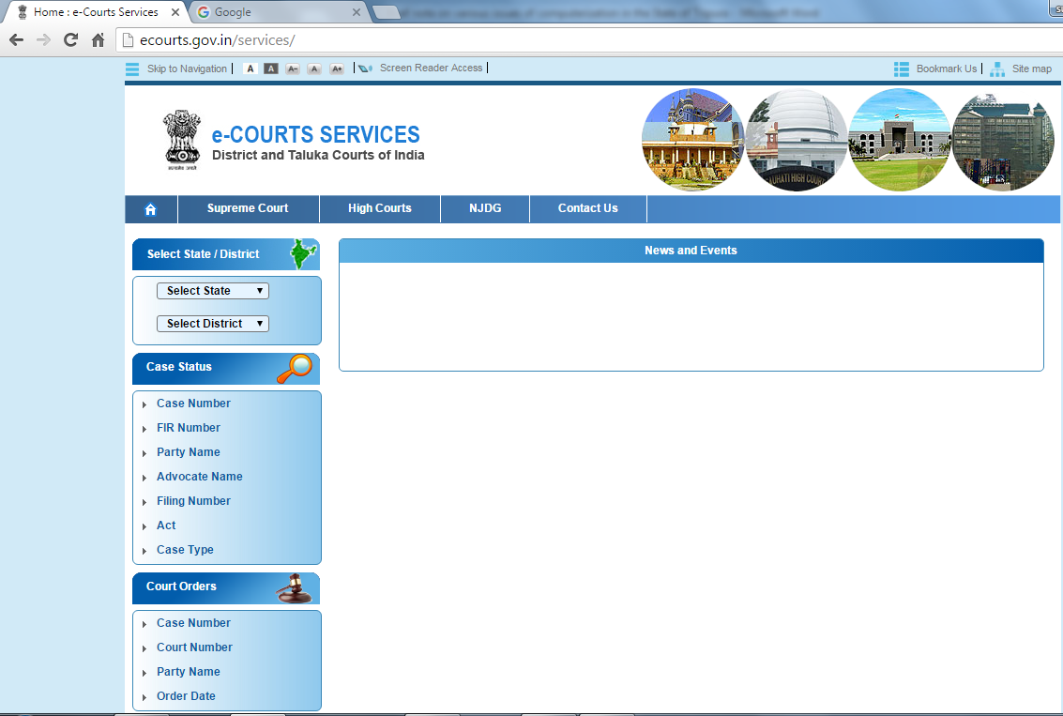
National judicial data grid ( njdg)

Slide 21
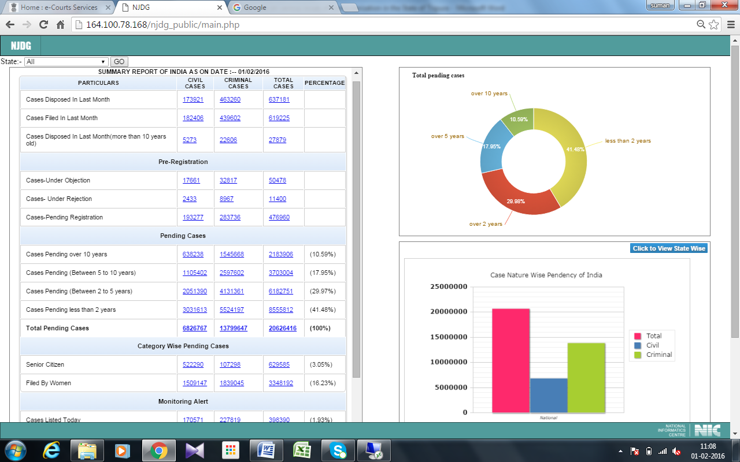

Slide 23
Month-wise eTransactions through eCourts National portal
07-08-2013 to 31-08-2013 1,05,790
01-09-2013 to 30-09-2013 13,42,894
01-10-2013 to 31-10-2013 31,09,045
01-11-2013 to 30-11-2013 41,33,381
01-12-2013 to 30-12-2013 1,34,87,618

Slide 24

It is fine to celebrate success, but it is more important to heed the lessons of failure.
Bill Gates

